Slide 1
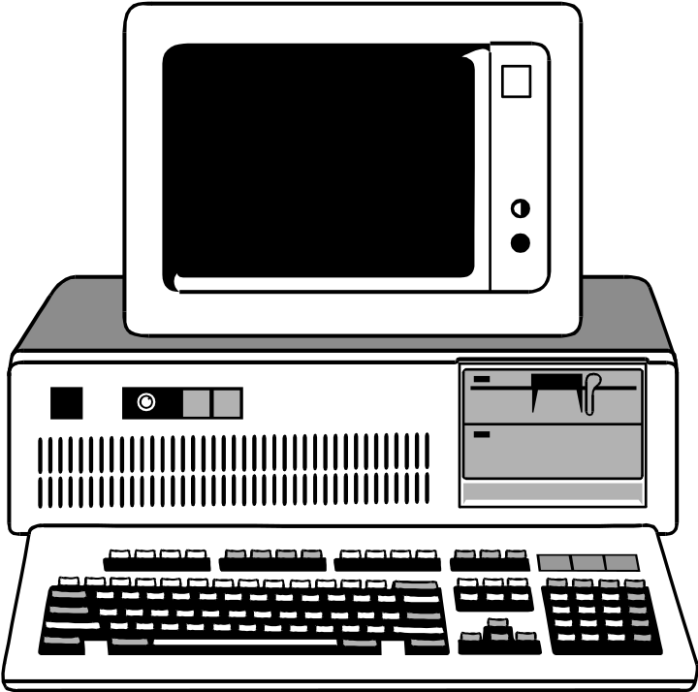
Programming
Hardware & Software

Slide 2
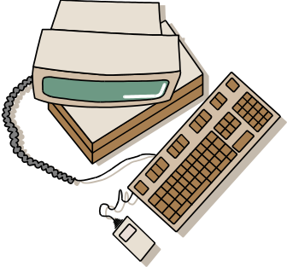
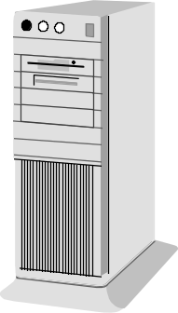
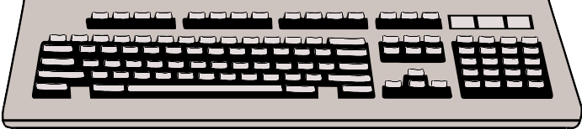
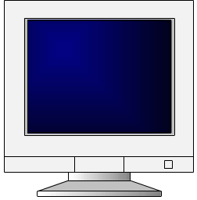
Hardware
Four components of a computer system:
  CPU - central processing unit
    Makes decisions, performs computations, and delegates input/output requests
  Memory: Disk Drives, CD drives, Tape drives, USB flash drives.
    Stores information
  Input devices: Keyboard, Mouse,
    Gets information from the user to the computer
  Output devices: monitor
    Sends information from computer to the user

Slide 3

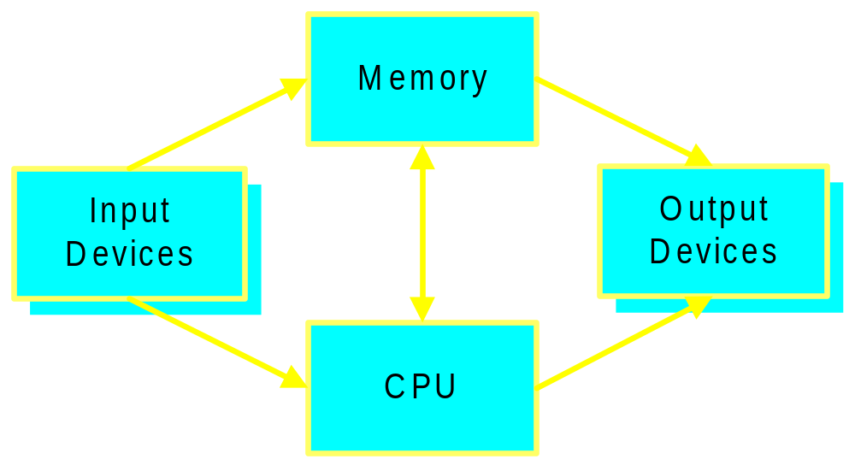
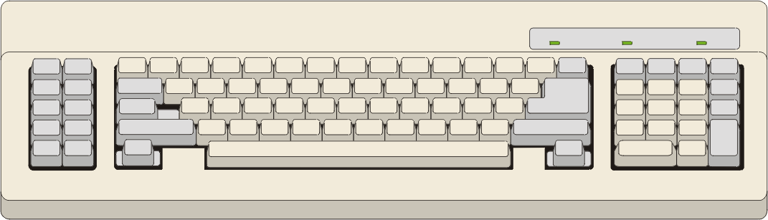
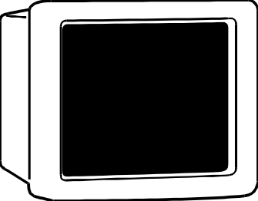
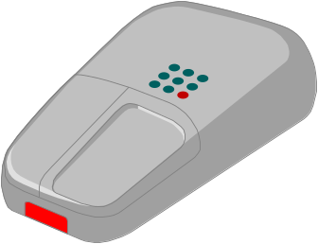

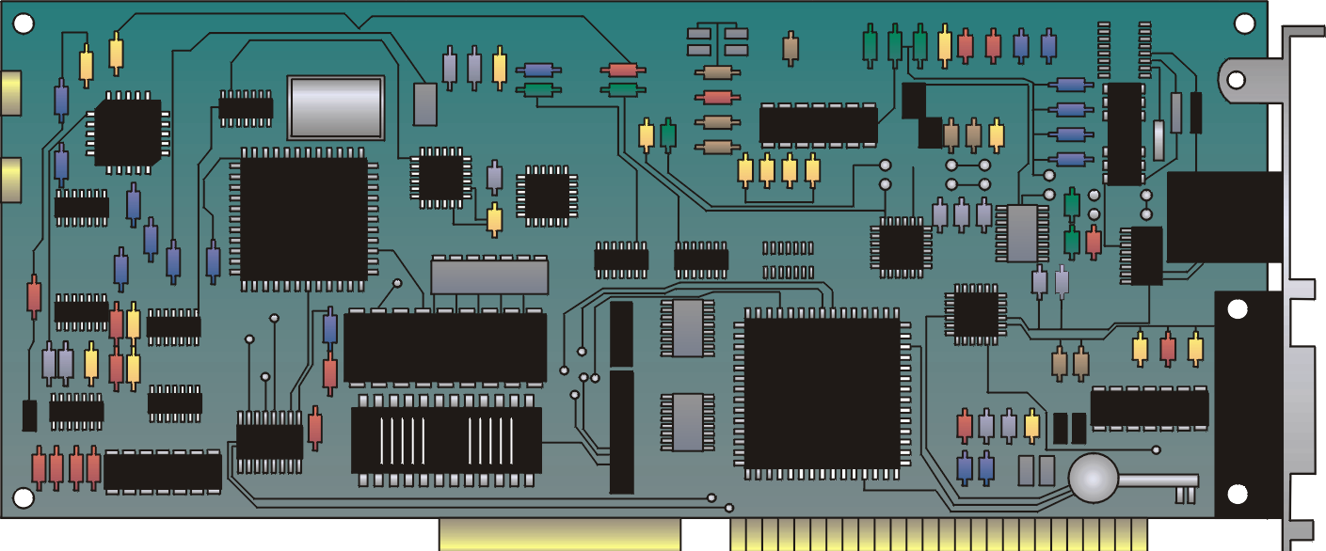

Hardware

Slide 4
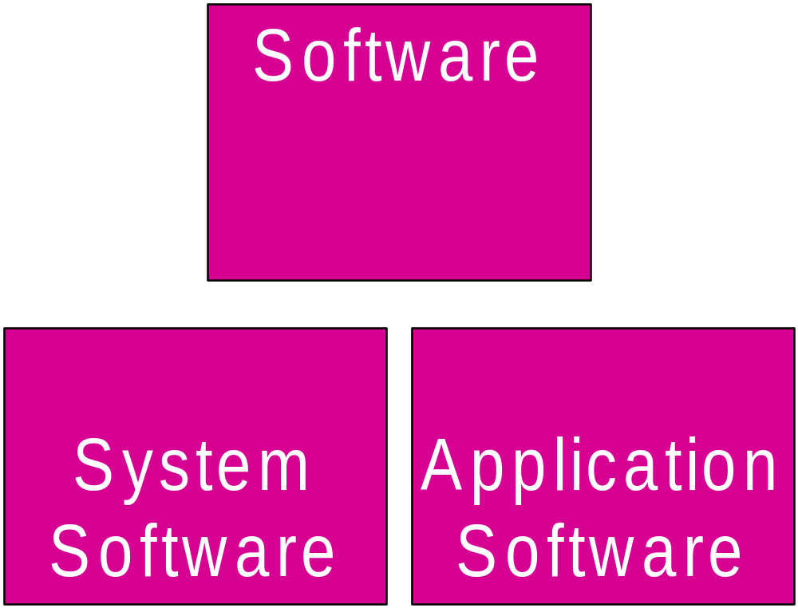

Slide 5


Software
Application software
  Easy-to-use programs designed to perform specific tasks
System software
  Programs that support the execution and development of other programs
  Two major types
    Operating systems
    Translation systems (compilers & linkers)

Slide 6
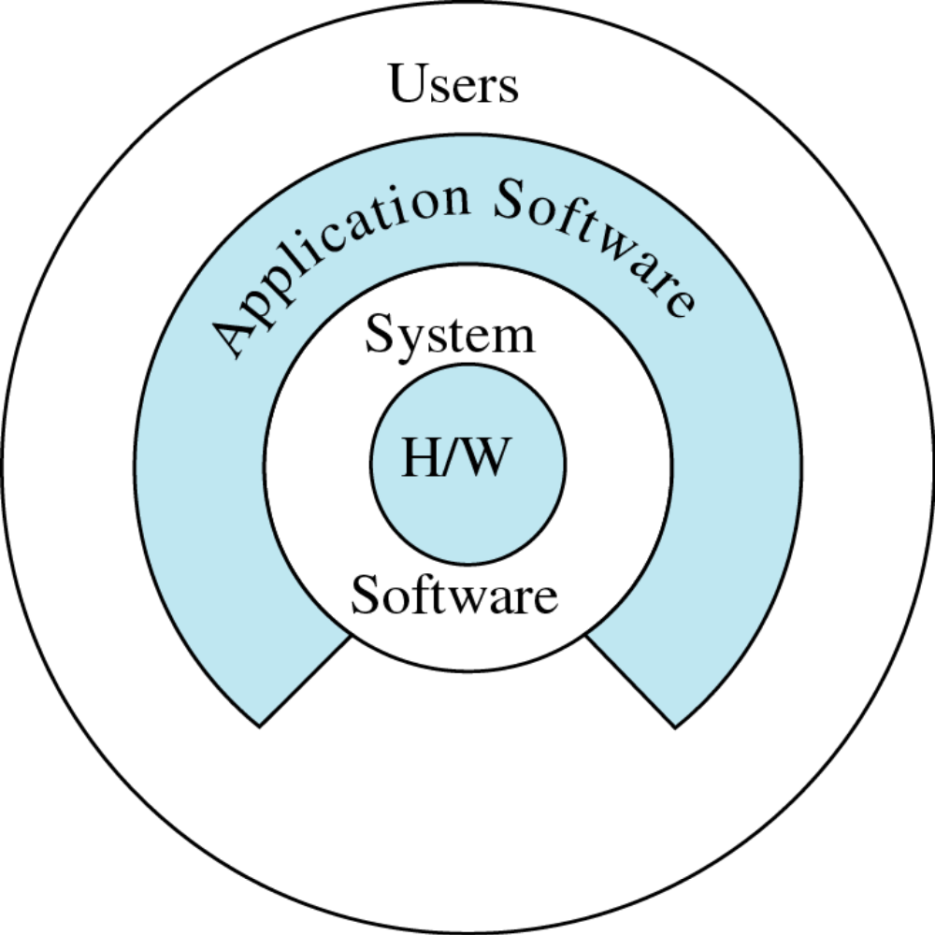
Copyright © 2000 by Brooks/Cole Publishing Company
A division of International Thomson Publishing Inc.

Slide 7
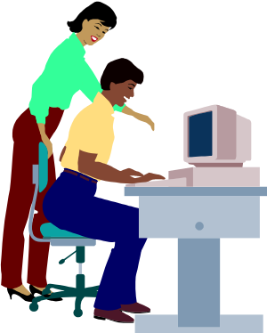
Computer Software Relationships
User Interface
Application Programs
User Interface
Operating System
User
Interface
Basic Input and Output Services (BIOS)
needed for a computer to boot up
Computer Hardware

Slide 8




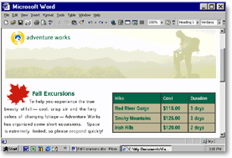

Application Software
Application software makes computer popular and easy to use
Common application software:
  Microsoft Word, WordPerfect
  PowerPoint
  Netscape, Internet Explorer
  PhotoShop, Photo-Paint
  Quick Time
  Dreamweaver

Slide 9

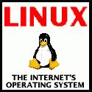
Operating System
Controls and manages the computing resources
Examples
  Windows, Unix, MSDOS,
Important services that an operating system provides:
  Security: prevent unauthorized users from accessing the system
  Commands to manipulate the file system
  Input and output on a variety of devices
  Window management

